Slide 1

Swift Popup-Course
Summer 2016
A.B.

Slide 2
About lecture
Feel free to pause and ask questions!
3 lectures a week
6 lectures in total
Optional

Slide 3
Learning Objective
Basic knowledge of swift programming language
Ability to code simple applications with swift

Slide 4
About Course
Consists of exercises
Weekly lectures (optional)
10 exercises → 1 credit
20 exercises → 2 credits
30 exercises → 3 credits
5 exercises each day

Slide 5
About exercises
Found from Google Docs
5 exercises after each lecture
Return via email

Slide 6
Useful material
Swift Book
Swift guide
Swift Videos
Links available at Google Docs

Slide 7
Getting Started
Download ’XCode’ if you’re on mac from AppStore
Follow installation instructions if you’re on ubuntu. (link found in Google Docs!)

Slide 8
REPL - Read Eval Print Loop
Open console and type in ”swift”
Automatic code check
Great for testing!
Comes with useful information: type ’.’ and hit shift

Slide 9
Printing! Here we go!
In order to display something on the console, type in print(”hello!”)

Slide 10
About syntax
”;” is optional!

Slide 11
Variables
Different types of variable declerations: constants: let a = ”Cannot be changed” variables: var b = ”Can be changed”
Variable’s type can be clarified by following: var x: String

Slide 12
Types of variables
Int, Double, String, Character, Bool and even more!

Slide 13
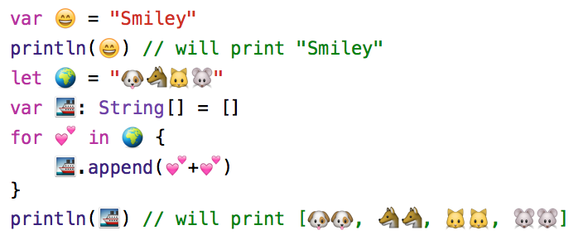
Variables can be named with emojis!

Slide 14
Working with variables
If there’s a variable that you haven’t set a value to yet: var variable_name: Int // and if you want to set a value variable_name = 123
To print your variable you can do: print(”\(name_of_your_variable)”) you can also do: print(”Value is \(name_of_your_variable)”)

Slide 15
Arithmetics!
All basic arithmetics symbols work, they are for example *,/,+,-
Example: var a: Int = 2 var b: Int = 3 var c: Int = a + b
Arithmetics inside print: print(”\(1 + 2 + 3)”)

Slide 16
Adding strings together
var a: String = ”co” var b: String = ”ol” var c: String = a + b print(”\(c)”)

Slide 17
If statement with variables
// Operators: <, >, ==, <=, >=, != var x: Int = ”happy” if (x == ”happy”) { print(”:)”) } else if (x == ”sad”) { print(”:(”) } else { print(”???”) }

Slide 18
Google Docs now available!
5 exercises are available at google docs link can be found from email.
Format: // Exercise 1 code1 // Exercise 2 code2 // Exercise 3 code 3 // Exercise 4 code 4 // Exercise 5 code 5

Slide 19
Course Timetable
Wednesday rescheduled!

